Slide 1
MOVIE QUERY
Screlea Vlada
Ionescu Elena

Slide 2
The Purpose of the Project
An application that searches for movies based on it’s attributes
Tuples will be formed from the dataset using the RDF algorithm after the creation of the ontology

Slide 3
WHAT WE HAVE DONE SO FAR…
Creating a dataset containing movies from IMDB
An entry from the dataset contains the following attributes: id, title, release year, type, genres, rating, directors, actors, duration, languages
The data set was obtained by doing web scrapping in python on a library that has access to the IMDB site. For faster processing, threads were used to search and store data in parallel

Slide 4
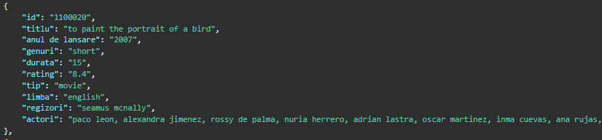
Example input from dataset
The number of entries : 36 266

Slide 5

WHAT WE HAVE DONE SO FAR…
Creating an ontology (creating classes, defining relationships between classes)
Ontology was created using Protégé software

Slide 6
Our ontology
Main Entities:
1. Film
- Properties:
- Title (string)
- Release Year (int)
- Rating (float)
- Duration (int)
- Type (string)
- Relations:
- Has one or more directors
- Has one or more actors
2. Director
- Properties:
- Name (string)
- Relations:
- Directed one or more films
3. Actor
- Properties:
- Name (string)
- Relations:
- Acted in one or more films
Relations:
- Directed: Link between a director and a film they directed.
- Acted in: Link between an actor and a film they acted in.

Slide 7
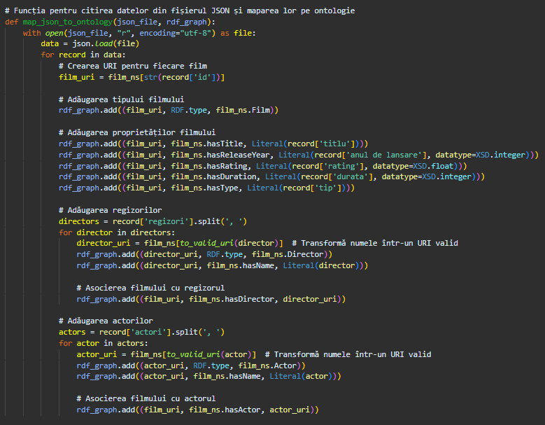
WHAT WE HAVE DONE SO FAR…
Mapping JSON Data to RDF using Existing
Technologies Used:
1.Python for writing the code.
2.RDFLib for handling RDF data.
3.JSON files for storing movie data.
4.OWL ontology for defining the structure and relationships within the movie domain.
Key Steps:
1.Loading the Ontology: Using RDFLib to load the existing ontology into an RDF graph.
2.Mapping the Data: Iterating through the JSON file and adding each movie as an RDF entity to the graph, adhering to the structure and relationships defined in the ontology.
3.Writing the RDF Graph: Saving the resulting RDF graph to an RDF/XML file for further use.

Slide 8
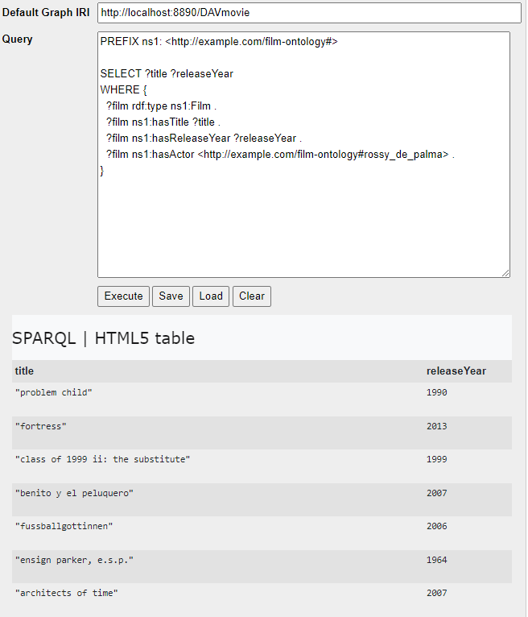
WHAT WE HAVE DONE SO FAR…
Using sparql for queries with Virtuoso Conductor (http://localhost:8890/conductor/)
Graph IRI: http://localhost:8890/DAVmovie
PREFIX ns1: <http://example.com/film-ontology#>
SELECT ?title ?releaseYear
WHERE {
?film rdf:type ns1:Film .
?film ns1:hasTitle ?title .
?film ns1:hasReleaseYear ?releaseYear .
?film ns1:hasActor <http://example.com/film-ontology#rossy_de_palma> .
}

Slide 9
WHAT WE HAVE DONE SO FAR…
PREFIX ns1: <http://example.com/film-ontology#>
SELECT ?title ?releaseYear
WHERE {
?film rdf:type ns1:Film .
?film ns1:hasTitle ?title .
?film ns1:hasReleaseYear ?releaseYear .
?film ns1:hasDirector <http://example.com/film-ontology#vicente_villanueva> .
}
PREFIX ns1: <http://example.com/film-ontology#>
SELECT ?title
WHERE {
?film rdf:type ns1:Film .
?film ns1:hasTitle ?title .
?film ns1:hasReleaseYear "2017"^^xsd:integer .
}

Slide 10
WHAT’S NEXT?
Problems
Small data volume – removing the movies which contained empty attributes
Errors writing and processing RDF data
Improving the database
Ontology improvement
Using inference

Slide 11
Thank you!
Questions?

